Slide 1
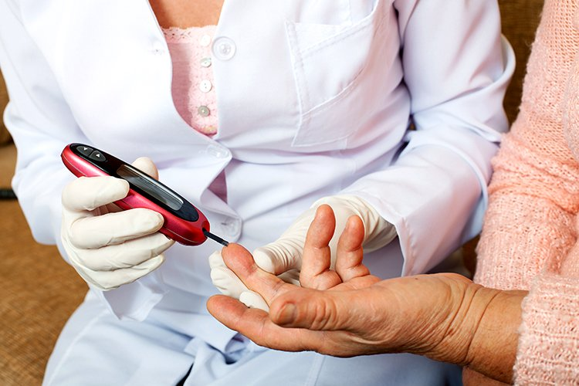

Early Detection of Diabetes
Rime Saad
Data Science Intensive Capstone Project
April 21, 2021

Slide 2
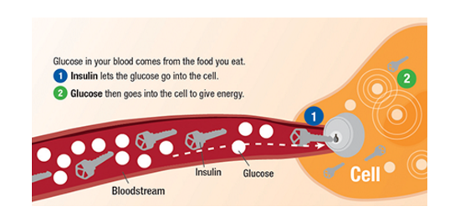
What is Diabetes?
When we eat, food gets digested by our bodies and turned into energy in the form of glucose
Glucose gets absorbed by the cells with the help of a key, which is the insulin hormone.

Slide 3
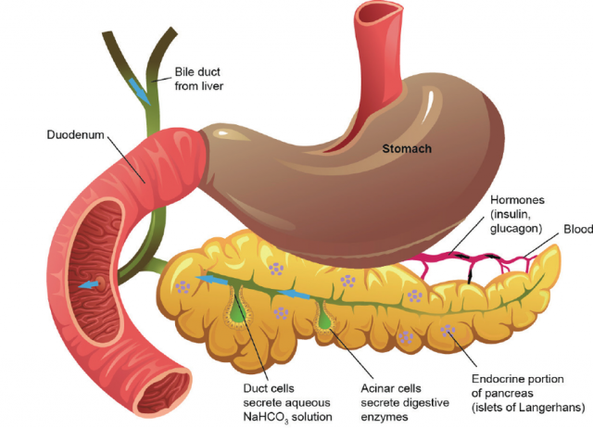
The problem is for diabetic patients, their pancreas does not produce enough insulin or their cells do not respond to it, so glucose continues to build up in their cells
Pancreas

Slide 4
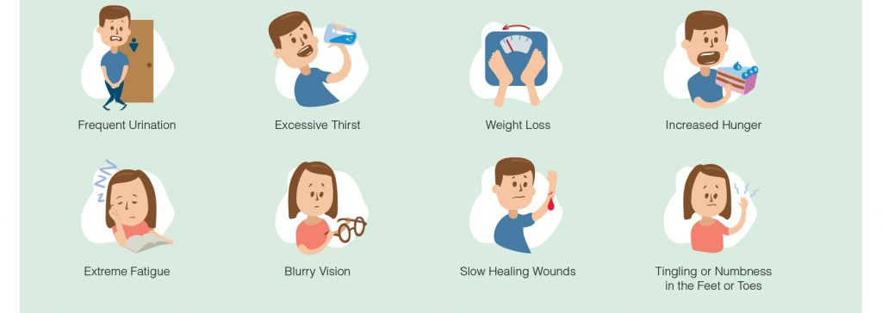
Some of the symptoms include

Slide 5
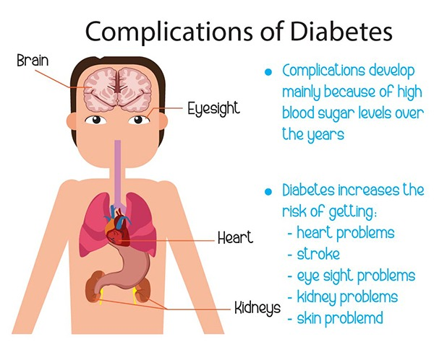
Build up of sugar in the bloodstream can cause:
Heart disease
Nerve damage
Kidney disease
Dementia
eye problems
Skin problems
Complications of Diabetes

Slide 6
The Problem
Can diabetes be detected early, before too much damage has occurred

Slide 7
Data Information
Date Data Acquired: December 2020
Location where it was acquired:
This dataset has been collected using direct questionnaires from the patients of Sylhet Diabetes Hospital in Sylhet, Bangladesh and approved by a doctor

Slide 8
The Data
The data has 17 variables all are categorical except for age, which is continuous
Age
Gender
Polyuria excessive urination
Polydipsia excessive thirst
sudden weight loss
Weakness
Polyphagia excessive hunger
Genital thrush
visual blurring
Itching
Irritability
delayed healing
partial paresis
muscle stiffness
Alopecia hair loss
Obesity

Slide 9
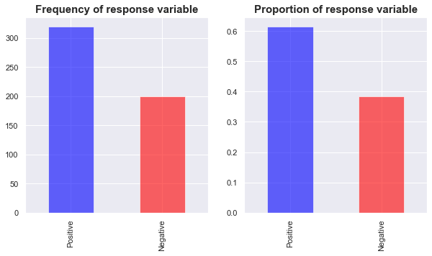
Frequency and proportion of response variable

Slide 10
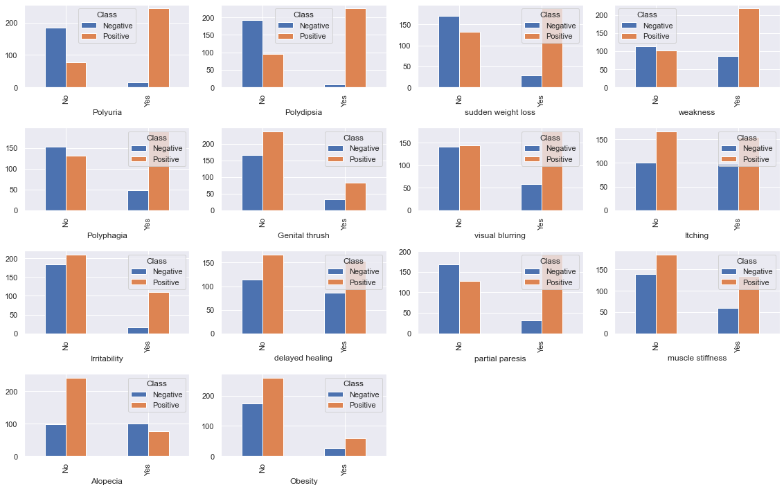
This is all the features comparing them to the target variable

Slide 11
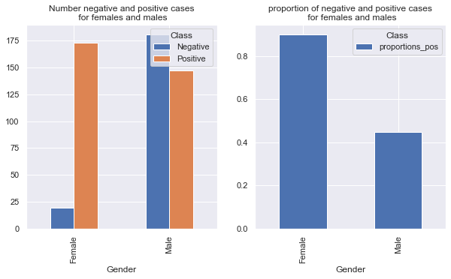
Females to males who tested positive
First Hypothesis to be tested is to test if females test positive more than males by performing a proportion z_test. We were able to reject the null hypothesis

Slide 12
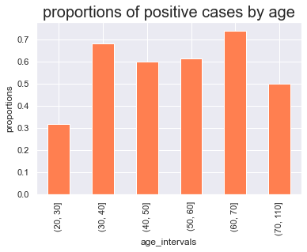
Proportions of positive cases by age
The second hypothesis to be tested is if there is a relationship between age and getting the disease, so perform a chi squared test.
The result was significant which means I can reject the null hypothesis that there is no connection, and that age matters.

Slide 13
Machine Learning Modeling

Slide 14
Overview
Supervised Learning
Classification: 1 for positive test, 0 for negative
Somewhat imbalanced data

Slide 15
Modeling Steps
Data preprocessing
Split data into X and y, y being the response variable
Normalize Age variable
Hot encode all categorical variables
Train test split (80,20)
HyperParameter Tuning:
Perform cross validation and hyperparameter tuning:
5 fold cv
Gridsearch or Random search
Evaluate with area under the ROC curve and area under the precision_recall curve
Classifier training using optimal parameters and 80% of data
Test classifier using test set

Slide 16
Classification Algorithms Used:
Logistic Regression
Knearest Neighbor Classifier
Decision Tree
Random Forest

Slide 17
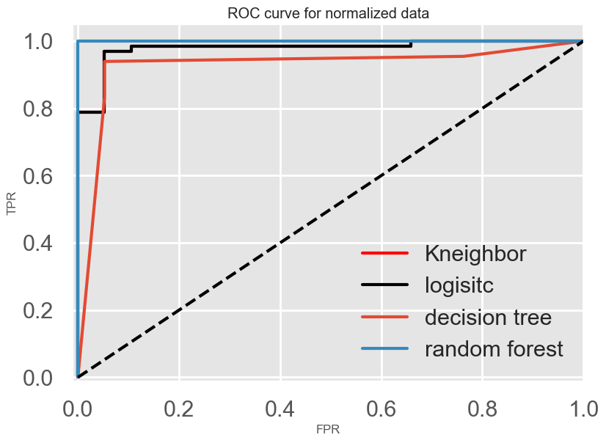
Model Comparison:
Receiver Operator Characteristic curve

Slide 18
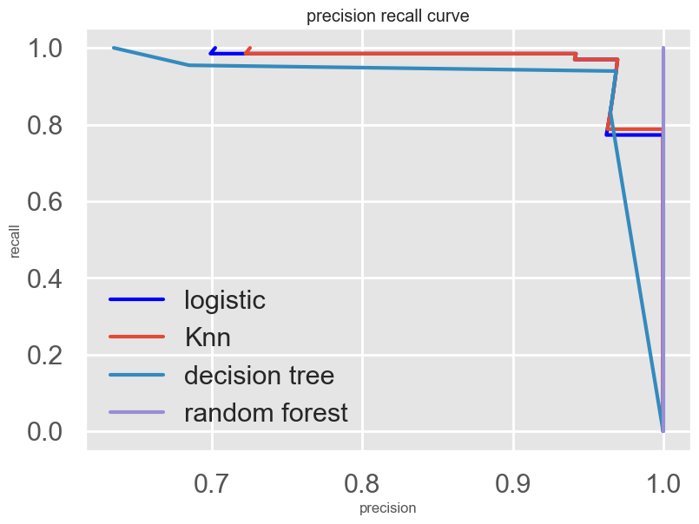
precision recall curve

Slide 19
Metrics For Models:
ROC_AUC
PR_AUC
F1 Score
Logistic Regression
KNeighborsClassifier
Decision Tree
Random Forest
0.9789
0.9789
0.9262
1.0
0.9879
0.9888
0.9638
0.9999
0.96
0.98
0.95
1.00
Second best model
Best model

Slide 20
Ideas to Improve the model:
Add blood and insulin tests to the dataset and test it on a larger number of patients to improve its efficacy.
When the models were run on different training and test sets, they gave slightly different results with Kneighbors classifier sometimes outperforming Random forest. So run these two models a 100 times on 100 different train and test sets and then perform a t_test to see if there is a significant difference between the mean of the metrics. This will give a more accurate result

